Slide 1
Bias Complexity Tradeoff aka Bias Variance Tradeoff
By Dr Shantanu Pathak

Slide 2
Bias and Complexity(Variance) in Prediction models
Bias in Model:
Bias is Assumptions
More bias : simple model
Complexity(Variance) in Model
Variance is how much model changes based on different training samples
More Variance : Complex Model

Slide 3
Components of Total Loss
Total Loss / Error of Model
Baseline Loss / Error – Irreducible Error
Error due to Bias
Error Due to variance
Total loss is sum of all of the above

Slide 4
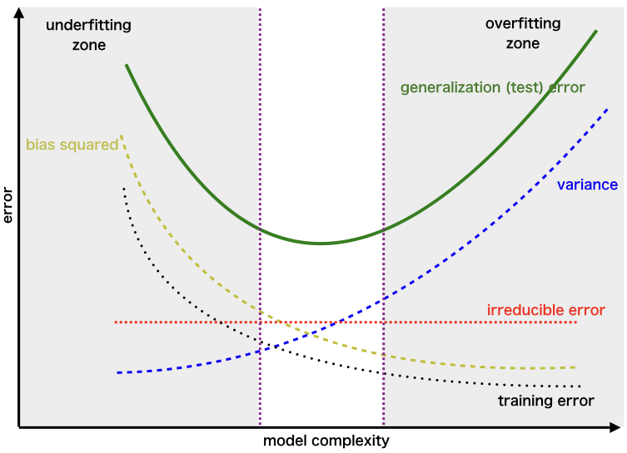
Overfitting & Underfitting

Slide 5
Loss Curve Diagram Explanation
X axis : Model Complexity
No of iterations
No of features
No of samples
Value of Coefficients
Y axis : Loss /Error
Any types of loss / cost function
Under-fit: When training loss and test (generalization) loss both are high
Over-fit : When training loss is low but test ( generalization) loss is high
Optimal Model:
When Training loss and test (generalization) loss both are low

Slide 6
Solution
Solution to Under-Fitting
Increase Iterations of training
Increase data 🡪 rows ( samples) or columns (features)
Solution to Over-Fitting
Regularization ( L1 , L2 or Elastic-net)
Ensemble Learning

Slide 7
How Bagging SOLVES Variance problem ?
Bagging reduces variance
Bagging creates n Datasets from original using random selection
Randomly select rows
Randomly select columns
This random select helps reduce variance problem
Bagging doesn’t address bias
Because there is not iterative improvement

Slide 8
How Boosting solves Bias and Variance Both ?
Boosting has iterative improvement
One model is iteratively trained multiple times for improvement
Boosting combines result from n different models created
In every iteration of improvement one model is created
Every iteration updates the data using error in previous iteration
So, every model is different
Finally combination of results from all iterations helps reduce the variance

Slide 9
Extra Details of Bias Variance Calculations

Slide 10
Details of Bias Variance Calculations
Bias and variance calculation requires knowing true model
In real life datasets, this is not possible!!
So, we don’t have any direct method to do this
We can do guest work only!

Slide 11
Extra : New ERA of Bias & Variance

Slide 12
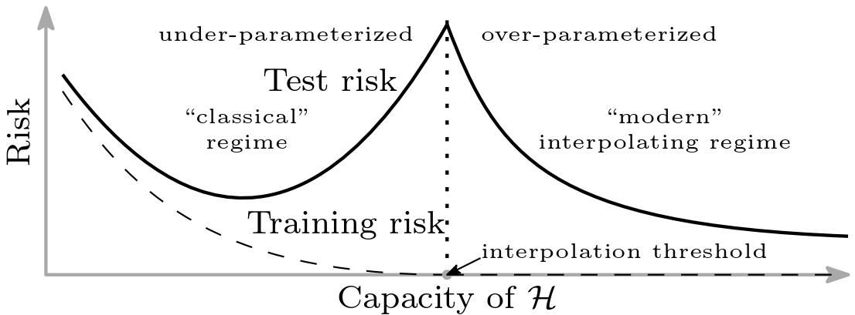
Bias & Variance in Deep Learning
Ref: https://www.pnas.org/content/116/32/15849

